Slide 1

Professional Practices (HUM-305)
SPRING SEMESTER 2026
By
Prof Engr Muhammad Raheel Iqbal Butt
Resource Person
Contact: +92 321 7433568
School of Computer & Information Technology
Beaconhouse National University, Lahore

Slide 2
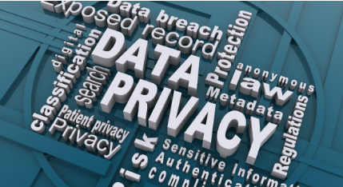

Slide 3
Chap 2: PRIVACY
Privacy Risks and Principles
What Is Privacy?
New Technology, New Risks
Terminology and Principles for Managing Personal Data
New Technologies, Supreme Court Decisions, and Expectation of Privacy
Search and Seizure of Computers and Phones Video Surveillance and Face Recognition
Marketing and Personalization
Our Social and Personal Activity
Location Tracking

Slide 4
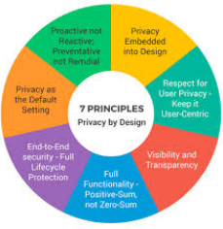
Privacy Risks and Principles

Slide 5
Privacy
What is Privacy?
Privacy means the right of individuals to control how their personal information is collected, used, stored, and shared.
In IT, privacy mainly concerns:
Personal data
Digital identity
Online behavior
Communication records

Slide 6
Privacy
Privacy Risks
Definition:
Privacy risks are potential dangers that may lead to unauthorized access, misuse, exposure, or loss of personal information.
Major Privacy Risks (with CS/IT Examples)
1: Data Breaches
When hackers gain unauthorized access to databases.
👉 Example: A cyberattack exposing user passwords from a company like Facebook.
2: Identity Theft
When someone steals personal information to impersonate another person.
Example: Using stolen CNIC or credit card details for fraud.

Slide 7
Privacy
3: Unauthorized Data Sharing
Organizations sharing user data without consent.
Example: An app selling user location data to third parties.
4: Surveillance & Tracking
Continuous monitoring of user activity online.
Example: Tracking browsing behavior through cookies by platforms like Google.
5: Insider Threats
Employees misusing customer data.
Example: A database administrator copying customer phone numbers.

Slide 8
Privacy
6: Weak Security Controls
Poor encryption, weak passwords, or outdated systems.
Example: Storing passwords in plain text instead of encrypted form.
7: AI & Big Data Misuse
Artificial Intelligence analyzing personal data without transparency.
Example: Facial recognition systems collecting biometric data without consent.

Slide 9
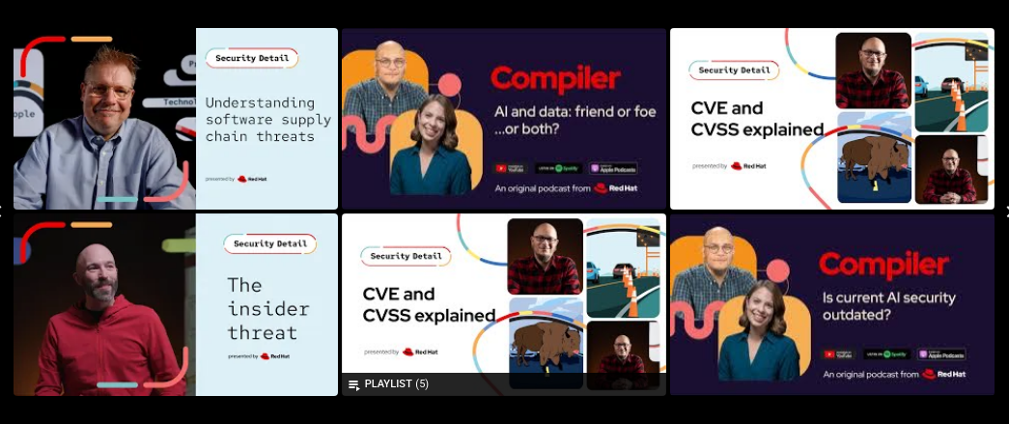
Video
https://youtu.be/Qcwk90n84vI

Slide 10
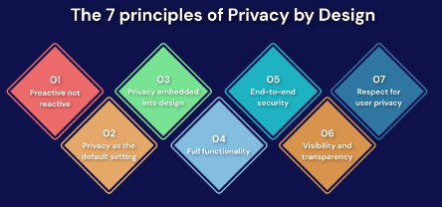

Slide 11
Privacy Principles
Privacy principles are guidelines that organizations must follow to protect personal information.
Many global frameworks define these principles, such as:
OECD Privacy Guidelines
General Data Protection Regulation (GDPR)

Slide 12
Privacy Principles
Core Privacy Principles
1: Lawfulness, Fairness & Transparency
Data must be collected legally and transparently.
Users must know:
What data is collected
Why it is collected
How it will be used
2: Purpose Limitation
Data should be collected for a specific purpose only.
Example: If data is collected for account creation, it should not be used for marketing without consent.

Slide 13
Privacy Principles
3: Data Minimization
Collect only necessary data.
Example: An online form should not ask for marital status if not required.
4: Accuracy
Data must be correct and updated.
Example: Allow users to update their profile information.
5: Storage Limitation
Do not store data longer than necessary.
Example: Delete inactive user accounts after a specific period.

Slide 14
Privacy Principles
6: Integrity & Confidentiality (Security)
Protect data using:
Encryption
Firewalls
Access controls
Authentication
7: Accountability
Organizations must be responsible for protecting user data.
Example: Appointing a Data Protection Officer (DPO).

Slide 15
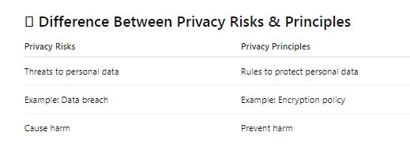

Slide 16
Types of Privacy
Types of Privacy
1 Information Privacy – Protection of personal data
2 Communication Privacy – Protection of emails, calls, messages
3 Physical Privacy – Freedom from surveillance
4 Decisional Privacy – Freedom to make personal choices

Slide 17
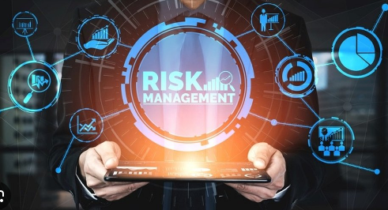

Slide 18
New Technology, New Risks
Modern technologies bring convenience but also increase privacy risks.
Examples of New Technologies & Risks
1: Artificial Intelligence (AI)
Collects and analyzes massive personal data.
Risk: Biased decisions, facial recognition misuse.
2: Social Media Platforms
Like Facebook and Instagram.
Risks:
Data mining
Targeted advertising
Identity theft

Slide 19
New Technology, New Risks
3: Cloud Computing
Data stored on remote servers.
Risk:
Data breaches
Unauthorized access
4: Internet of Things (IoT)
Smart devices (smart watches, CCTV, smart homes).
Risk:
Continuous surveillance
Location tracking

Slide 20
New Technology, New Risks
5: Big Data & Data Analytics
Companies like Google collect browsing history.
Risk:
Profiling users without consent
Behavioral tracking
Why New Risks Occur?
Large-scale data collection
Weak cybersecurity
Lack of user awareness
Complex AI algorithms

Slide 21
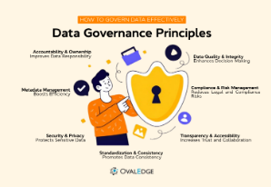

Slide 22
Terminology and Principles for Managing Personal Data
Important Terminology
1: Personal Data
Any information that identifies a person. Example: Name, CNIC, email, IP address.
2: Data Subject
The individual whose data is collected.
3: Data Controller
Organization that decides how data is used.

Slide 23
Terminology and Principles for Managing Personal Data
4: Data Processor
Entity that processes data on behalf of the controller.
5: Sensitive Data
Highly confidential data:
Health records
Biometric data
Financial information

Slide 24
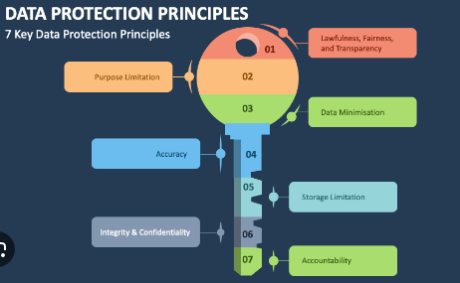

Slide 25
Principles for Managing Personal Data
Many laws like the General Data Protection Regulation (GDPR) define these principles:
1 Lawfulness & Transparency
Collect data legally and inform users.
2 Purpose Limitation
Use data only for specific purposes.
3 Data Minimization
Collect only necessary data.

Slide 26
Principles for Managing Personal Data
4 Accuracy
Keep data correct and updated.
5 Storage Limitation
Do not store data forever.
6 Security (Integrity & Confidentiality)
Use encryption and strong access control.
7 Accountability
Organizations must be responsible for data protection.

Slide 27
New Technologies, Supreme Court Decisions, and Expectation of Privacy
Expectation of Privacy
It means what level of privacy a person reasonably expects in a situation.
Example:
You expect privacy in your home.
You expect less privacy on public roads.

Slide 28
New Technologies, Supreme Court Decisions, and Expectation of Privacy
Role of Supreme Court
Courts decide how privacy rights apply to new technologies.
Example 1:
In the United States, the Supreme Court of the United States has ruled that:
Police need a warrant to access mobile phone data in certain cases.
GPS tracking without permission can violate privacy rights.
These decisions show that even with new technologies, privacy rights must be protected.
Technology vs Law Challenge
Technology evolves fast.
Law develops slowly.
Courts interpret constitutional rights in modern contexts.

Slide 29
CS / IT Professional Responsibility
CS / IT Professional Responsibility
As an IT professional, you must:
Design privacy-by-design systems.
Encrypt databases.
Protect user credentials.
Avoid unauthorized surveillance.
Follow ethical standards like those from Association for Computing Machinery

Slide 30
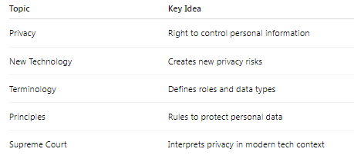

Slide 31
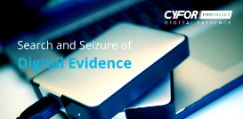

Slide 32
Search and Seizure of Computers and Phones
1) Search and Seizure of Computers and Phones
Meaning
Search and seizure refers to the legal authority of law enforcement agencies to search digital devices (computers, laptops, smartphones, servers) and confiscate them as evidence in criminal investigations.
Why It Is Important in IT
Computers and phones store:
Emails
Messages (WhatsApp, Messenger)
Photos and videos
Browsing history
Financial records
Cloud data
So digital devices often contain critical evidence.

Slide 33
Search and Seizure of Computers and Phones
Legal Framework
In the United States, digital searches are governed under the Fourth Amendment, which protects against unreasonable searches and seizures.
A landmark case:
Riley v. California The Supreme Court ruled that police must obtain a warrant before searching a mobile phone seized during an arrest.
Issues in Digital Search
Access to encrypted data
Cloud storage jurisdiction problems
Scope of warrant (how much data can be searched?)
Privacy of unrelated third parties
Ethical Concerns
Mass data copying
Retaining irrelevant personal data
Violating user privacy rights

Slide 34
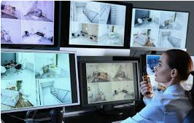

Slide 35
Video Surveillance and Face Recognition
2) Video Surveillance and Face Recognition
Video Surveillance
Use of cameras (CCTV, IP cameras, smart cameras) to monitor public and private spaces.
Examples:
Airports
Universities
Shopping malls
Smart cities
Benefits:
Crime prevention
Evidence collection
Public safety
Risks:
Constant monitoring
Chilling effect on freedom
Misuse by authorities

Slide 36
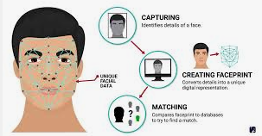

Slide 37
Face Recognition Technology (FRT)
Face Recognition Technology (FRT)
Face recognition uses AI algorithms to identify individuals from images or video.
How It Works:
Capture face image
Extract facial features
Match with database
Real-world Example:
Clearview AI – Scraped billions of images from the internet to create a face database.
Privacy Concerns:
Biometric data misuse
False positives (especially minorities)
No consent from individuals
Mass surveillance risks

Slide 38
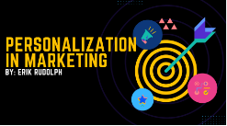

Slide 39
Marketing and Personalization
3) Marketing and Personalization
What Is It?
Companies collect user data to show personalized ads, recommendations, and content.
Example:
Google uses browsing history to personalize ads.
Facebook tracks likes, shares, and interests to target advertisements.
Data Used:
Search history, Purchase history, Location data, Social interactions, Device information
Benefits:
Relevant ads, Better user experience, Customized content
Risks:
Manipulation of behavior, Political micro-targeting
Data breaches, Loss of autonomy

Slide 40
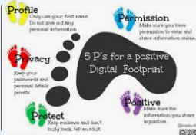

Slide 41
Our Social and Personal Activity (Digital Footprint)
4) Our Social and Personal Activity (Digital Footprint)
What Is Digital Footprint?
The trail of data we leave online.
Active Footprint:
Posting on social media, Commenting, Uploading photos
Passive Footprint:
Cookies, Background tracking, IP logging
Platforms Collecting Data:
Instagram, TikTok, LinkedIn
Risks:
Identity theft, Reputation damage, Profiling, Cyberstalking

Slide 42
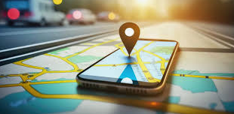

Slide 43
Location Tracking
5) Location Tracking
What Is Location Tracking?
Monitoring and recording a person's geographical position via:
GPS, Wi-Fi, Cell towers, Bluetooth beacons
Example:
Apple and Google collect location history for services like maps and recommendations.
Legal Case:
Carpenter v. United States The court ruled that accessing historical cell phone location records requires a warrant.
Risks:
Stalking, Government mass tracking, Behavioral profiling, Loss of anonymity

Slide 44
Conclusion
Conclusion
For Computer Science and IT professionals:
Understand privacy laws
Implement data minimization
Use encryption
Follow ethical data practices
Apply Privacy by Design principles
Technology creates convenience, but it also introduces serious privacy and ethical challenges. IT professionals must balance innovation with responsibility

Slide 45
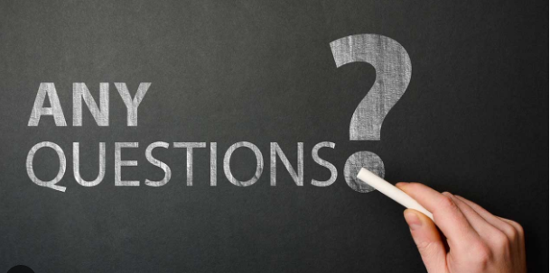

Slide 46


